Slide 1
DTM:
Don’t Tell Me
A memory game by Samuel Alston

Slide 2
Purpose
Google makes it easy to outsource our memory
As you recall less your brain gets weaker at recall

Slide 3
Proposal
Create an app that does Google searches for you -- but doesn’t give you the answer.
It gives you clues so you have to practice recall and association to remember something.

Slide 4
Features
Choose a category (movies and TV for alpha)
Ask a question
Choose your clue level (word association, trivia etc)
Track your progress and gain points for correct answers
Voice to text input

Slide 5
Phone Requirements
Internet Access
Access to microphone
Write to External Storage
Android 5+

Slide 6
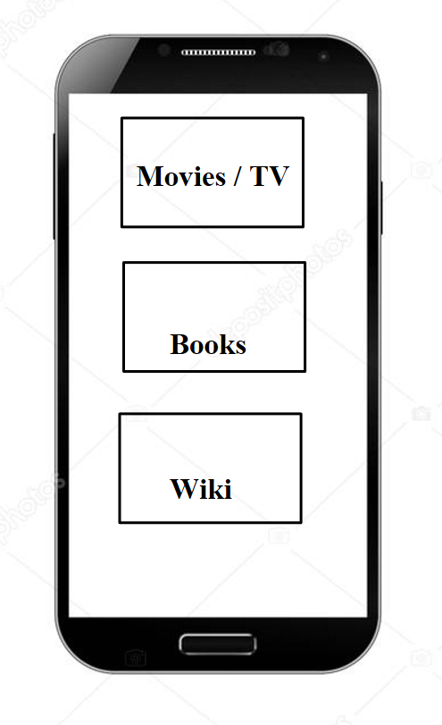
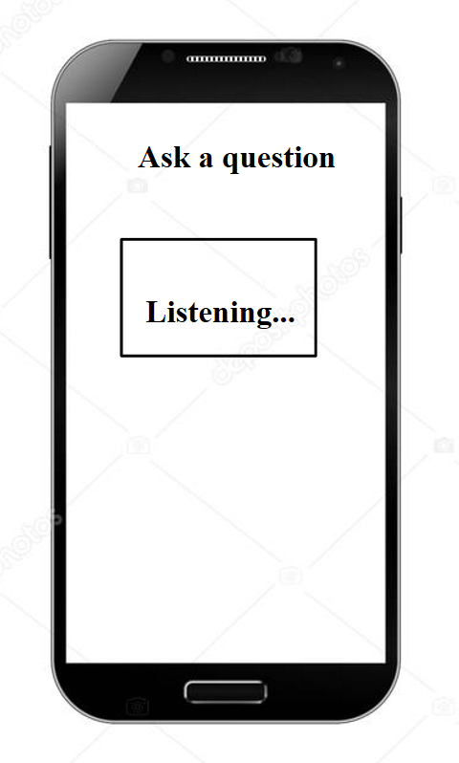
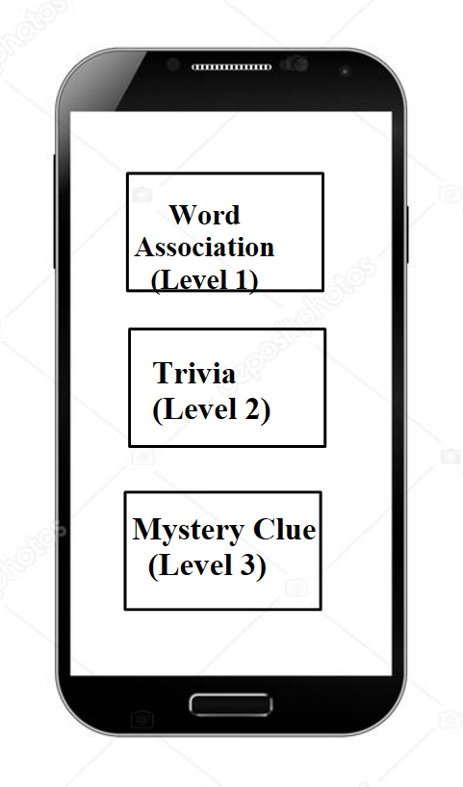
Mock-ups
Question:
“Who was the star of Braveheart?”
Clue:
“Australian actor, also starred in Lethal Weapon”

Slide 7
Anticipated Deliverables
March-- App takes Voice Input, returns search results
April-- Scrape for clues
May-- UI

